Slide 1
David Vs Goliath
1 Samuel 17 – Is there not a cause?

Slide 2
THE TEENAGER.
Notice Saul’s response!
Saul wants someone to fight FOR him. He isn’t willing to go up himself. Fear
Notice David’s faith!
Notice David’s zeal!

Slide 3
Psalm 55:12-14 12 For it was not an enemy that reproached me; then I could have borne it: neither was it he that hated me that did magnify himself against me; then I would have hid myself from him: 13 But it was thou, a man mine equal, my guide, and mine acquaintance. 14 We took sweet counsel together, and walked unto the house of God in company.

Slide 4
David’s promise of victory was based in his faith in God!
Vs 31 – Saul (fearful) now NEEDS a David! (the lost need Christ in their life.)
Vs 32 – Don’t miss the picture of Christ.

Slide 5
Saul’s doubt was biased on his own understanding.
When we do not walk by faith (looking to God) we walk by sight (looking to man.)
Saul gives an evil report!

Slide 6
Numbers 13:31-33 But the men that went up with him said, We be not able to go up against the people; for they are stronger than we. 32 And they brought up an evil report of the land which they had searched unto the children of Israel, saying, The land, through which we have gone to search it, is a land that eateth up the inhabitants thereof; and all the people that we saw in it are men of a great stature. 33 And there we saw the giants, the sons of Anak, which come of the giants: and we were in our own sight as grasshoppers, and so we were in their sight.

Slide 7
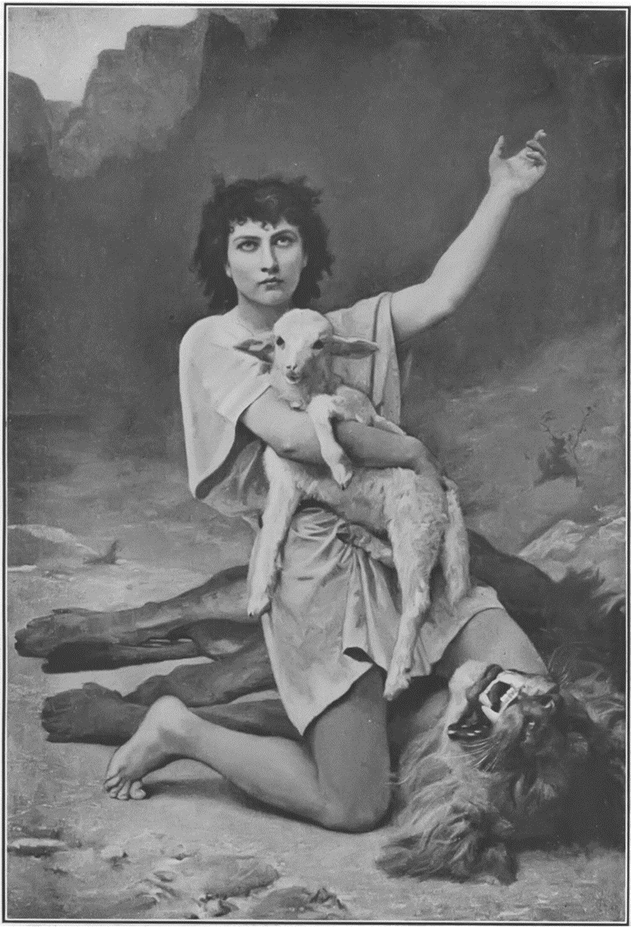
It aint braggin’ if it’s true!
When you know and trust in God, you will not fear those of this world.

Slide 8
1 Samuel 16:13 Then Samuel took the horn of oil, and anointed him in the midst of his brethren: and the Spirit of the LORD came upon David from that day forward. So Samuel rose up, and went to Ramah.

Slide 9
David’s provision for the battle was based in his faith in God and his experience in his service.

Slide 10
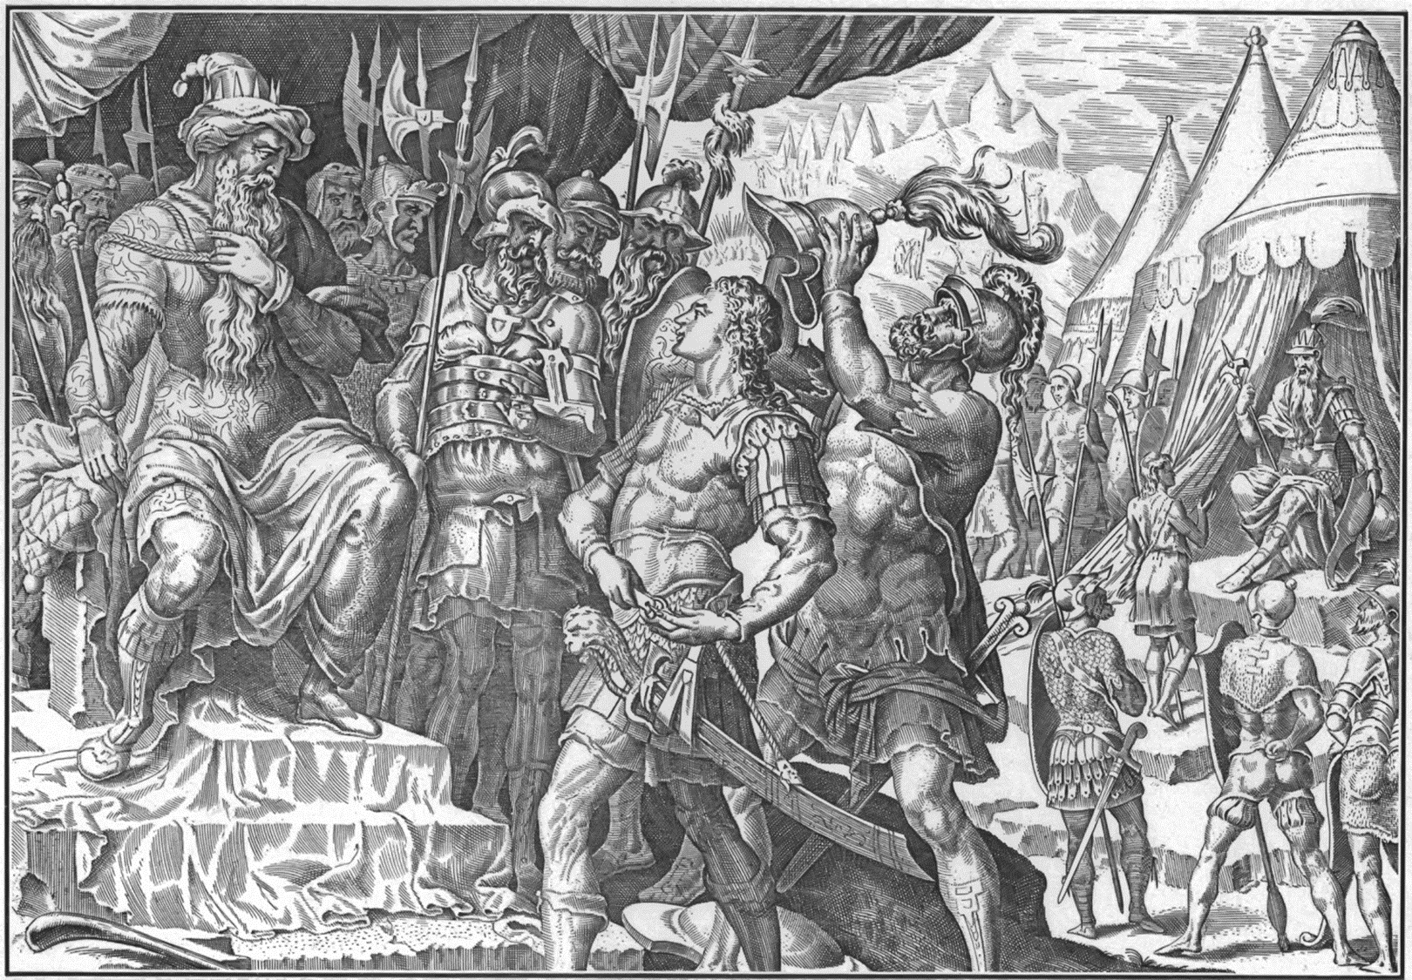

Slide 11
Don’t try to be what you’re not. Be yourself.
1 Thessalonians 5:21 Prove all things; hold fast that which is good.

Slide 12
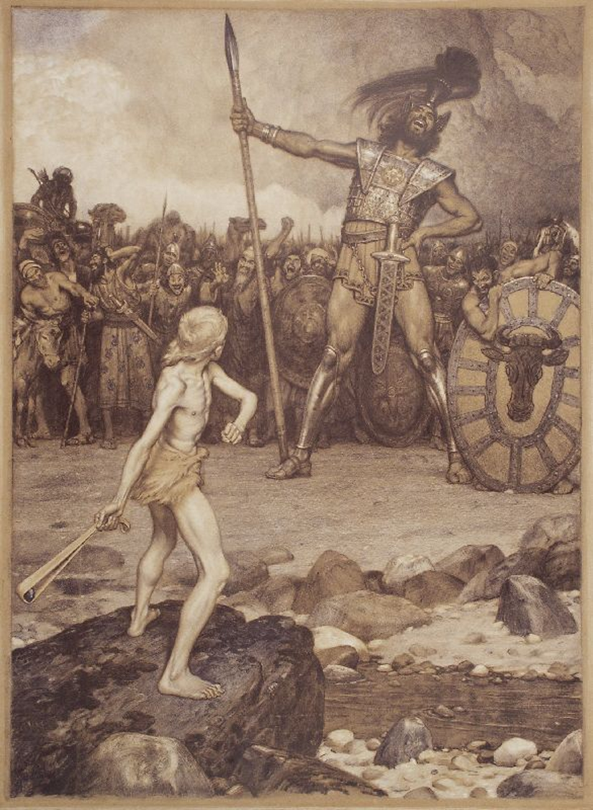
Use what it takes to get the job done.
What do you have?
David had a shepherd’s bag.
David knew the sling!

Slide 13
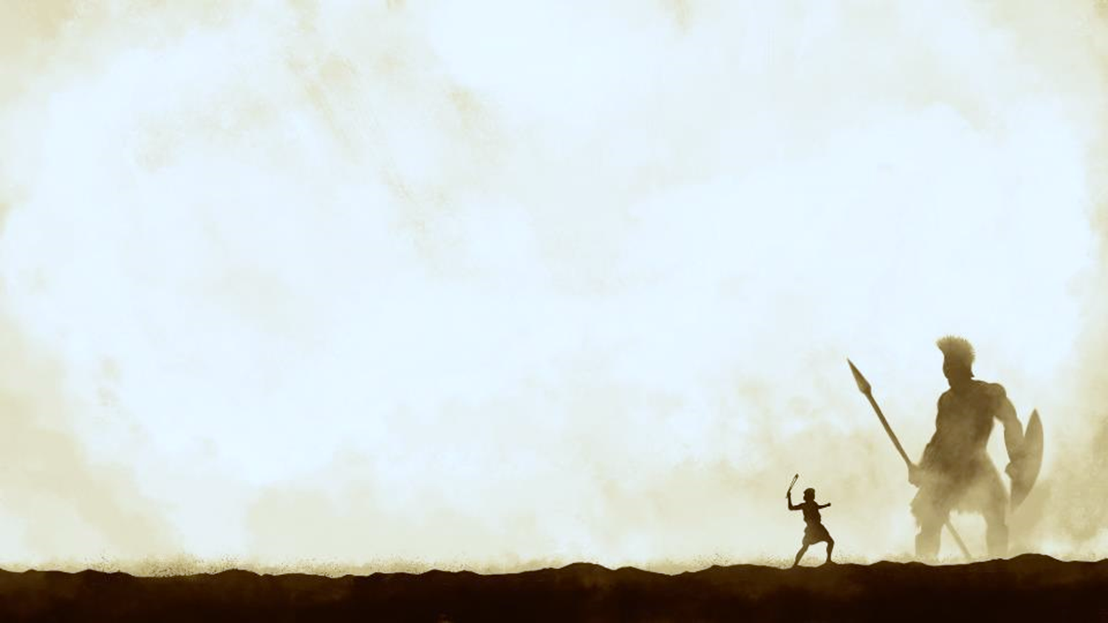
David’s promise of God’s judgment and vindication!
Stave = stick.
Proverbs 16:18 Pride goeth before destruction, and an haughty spirit before a fall.
Keep your boast in the Lord.

Slide 14
Exodus 9:16 And in very deed for this cause have I raised thee up, for to shew in thee my power; and that my name may be declared throughout all the earth.

Slide 15
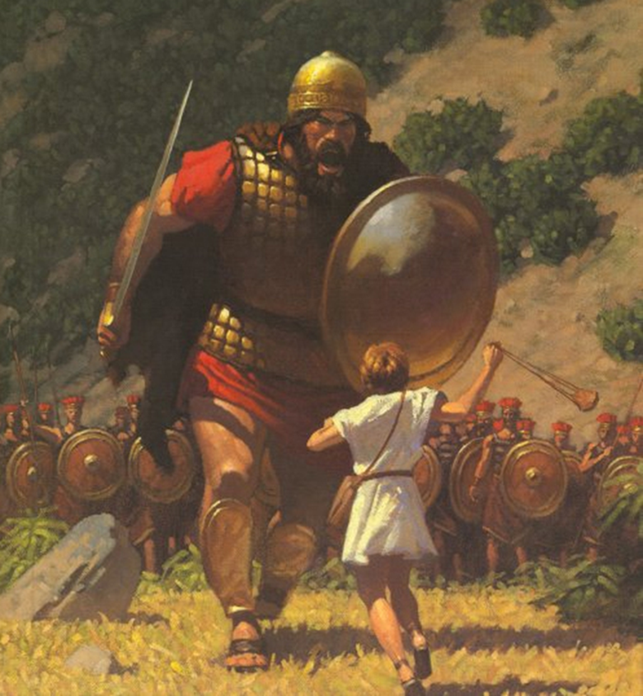
David’s victory in battle.
Move forward in faith.

Slide 16
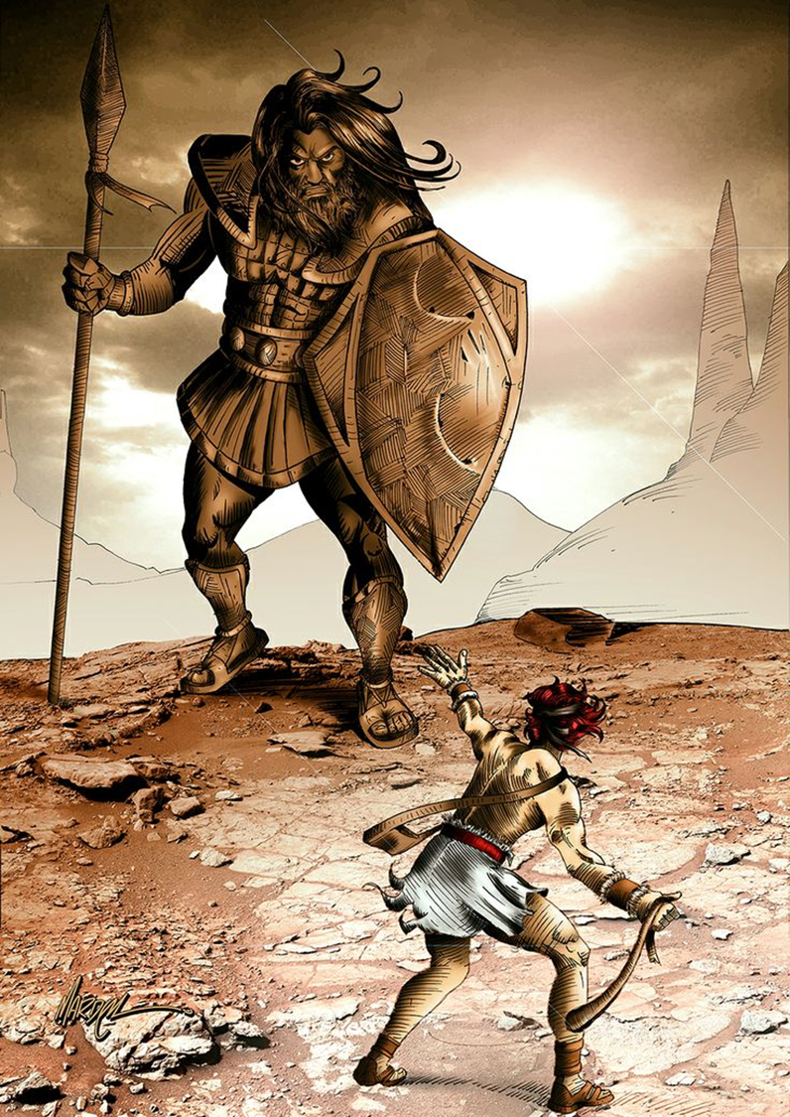
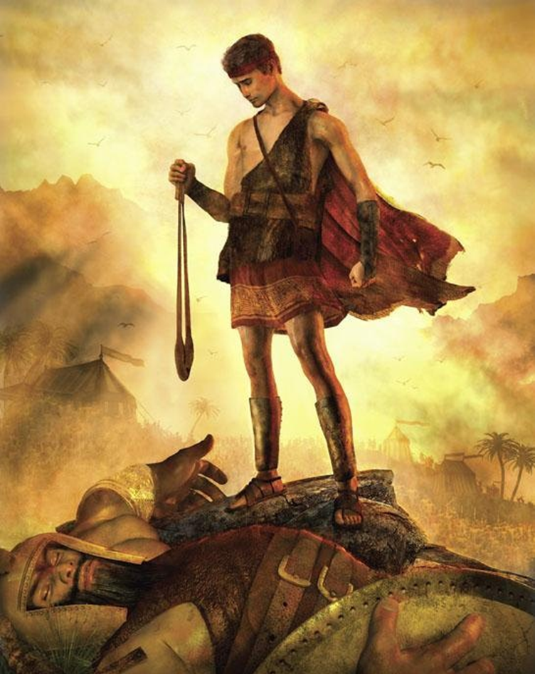

Slide 17
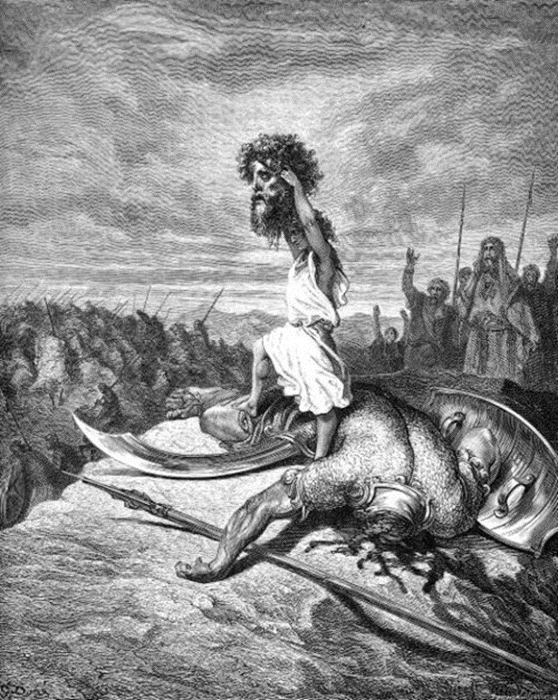
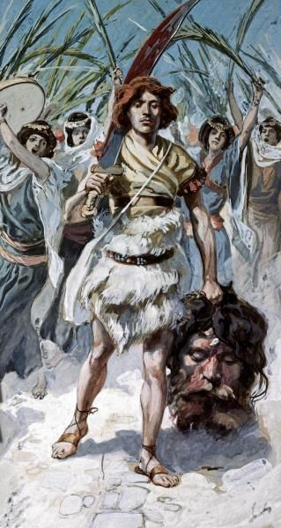

Slide 18
Small things
God used a teenage shepherd, a stone and a sling to bring the mighty to nothing.
That way God got all the glory.

Slide 19
Psalm 18:32-34 It is God that girdeth me with strength, and maketh my way perfect. 33 He maketh my feet like hinds' feet, and setteth me upon my high places. 34 He teacheth my hands to war, so that a bow of steel is broken by mine arms.

Slide 20
Paying attention to the picutre
Gen 3:15! Rev 13:3; Ps 68:21
Goliath’s death is by a stone! Dan 2:44-45 “the stone was cut out o the mountain without hands”
KEY: Blasphemers were to be stoned to death! Lev 24:16

Slide 21
Leviticus 24:16 And he that blasphemeth the name of the LORD, he shall surely be put to death, and all the congregation shall certainly stone him: as well the stranger, as he that is born in the land, when he blasphemeth the name of the LORD, shall be put to death.

Slide 22
Notice that the Philistines didn’t abide by the rules of engagement!
The enemies of God are not full of Christian character.

Slide 23
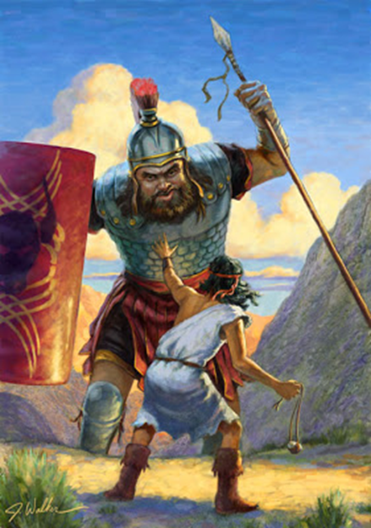
David’s victory was Israel’s victory.
God’s people share in the victory of their king!

Slide 24
1 Corinthians 15:54-57 So when this corruptible shall have put on incorruption, and this mortal shall have put on immortality, then shall be brought to pass the saying that is written, Death is swallowed up in victory. 55 O death, where is thy sting? O grave, where is thy victory? 56 The sting of death is sin; and the strength of sin is the law. 57 But thanks be to God, which giveth us the victory through our Lord Jesus Christ.

Slide 25
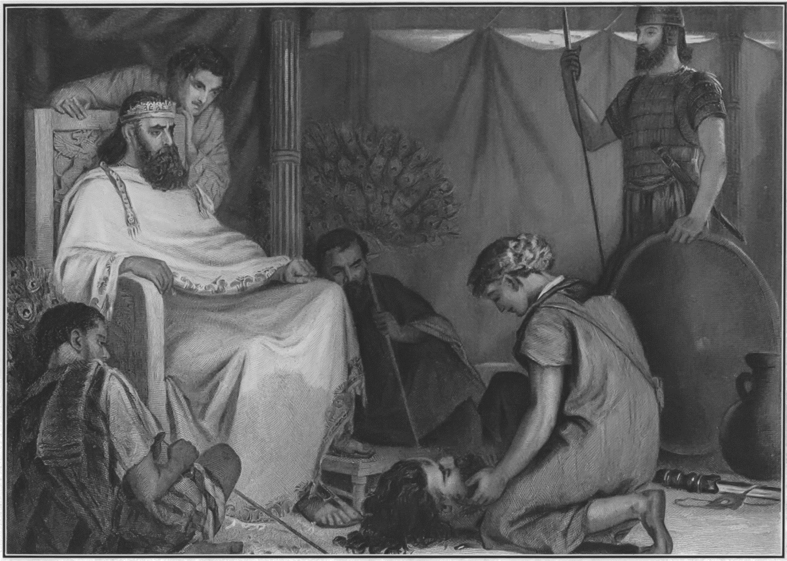

Slide 26
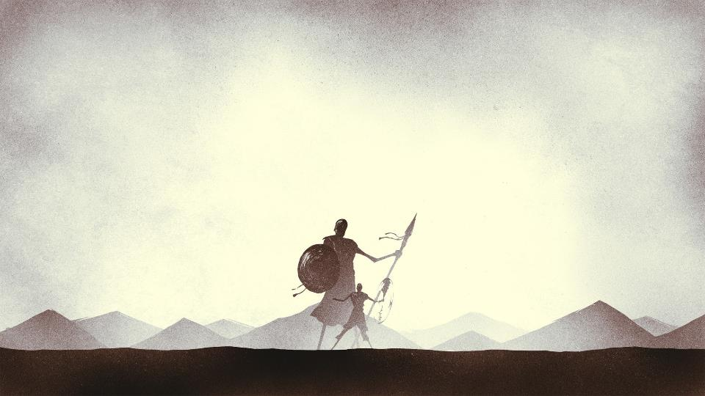
David Vs Goliath
1 Samuel 17 – Is there not a cause?

